Slide 1
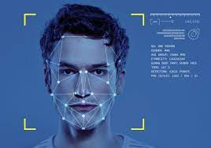
FACE RECOGNITION ATTENDANCE SYSTEM

Slide 2

FACE RECOGNITION ATTENDANCE SYSTEM
Department of Information Technology
Swami Keshvanand Institute of Technology, Management & Gramothan, Jaipur
Rajasthan Technical University, Kota
Session 2022-23
SUBMITTED TO:
Mrs. Richa Rawal
(Associate Professor)
LAB COORDINATOR:
Mrs. Sanju Chaudhary
(Associate Professor)
SUBMITTED BY:
Ishika Agarwal (19ESKIT032)
Kritika Surana (19ESKIT046)
Kunal Bhargatiya (19ESKIT048)
Lavanya Jain (19ESKIT051)

Slide 3
TABLE OF CONTENTS
Introduction
Abstract
Requirement
User Interface
System Flow
Haar Cascade Algorithm
LBPH Algorithm
Training Model
Applying LBPH Algorithm
Extracting Histogram
Performing the face recognition

Slide 4
INTRODUCTION
The purpose of the Face recognition Attendance System is to ease the attendance process which consumes lot of time and efforts , it is a convenient and easy way for students and teacher.

Slide 5
ABSTRACT
Attendance will be monitored by the face recognition algorithm by recognizing only the face of the students from the rest of the objects and then marking them as present. The system will be pre feed with the images of all the students and with the help of this pre feed data the algorithm will detect them who are present and match the features with the already saved images of them present in the database.

Slide 6
REQUIREMENT
Minimum RAM: 256 MB
Hard Disk: 40 GB
Processor: Intel Pentium 4
Operating System: Windows OS, Linux OS, UNIX OS and Mac OS.

Slide 7
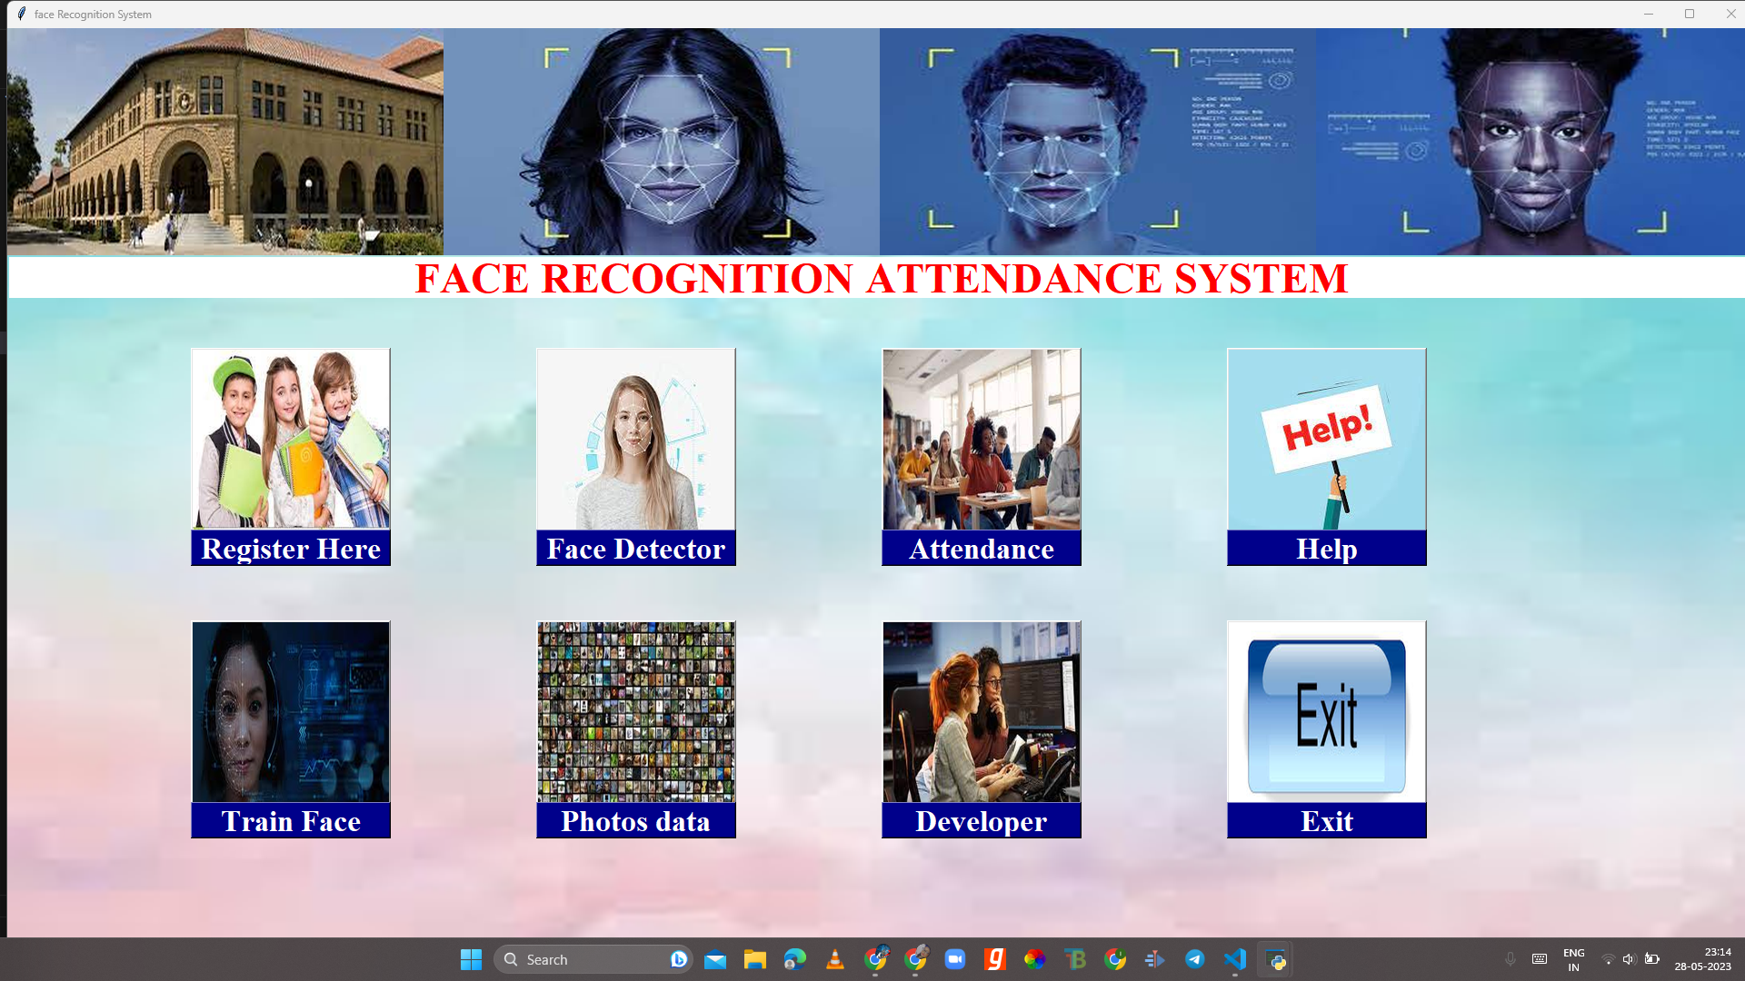
USER INTERFACE

Slide 8
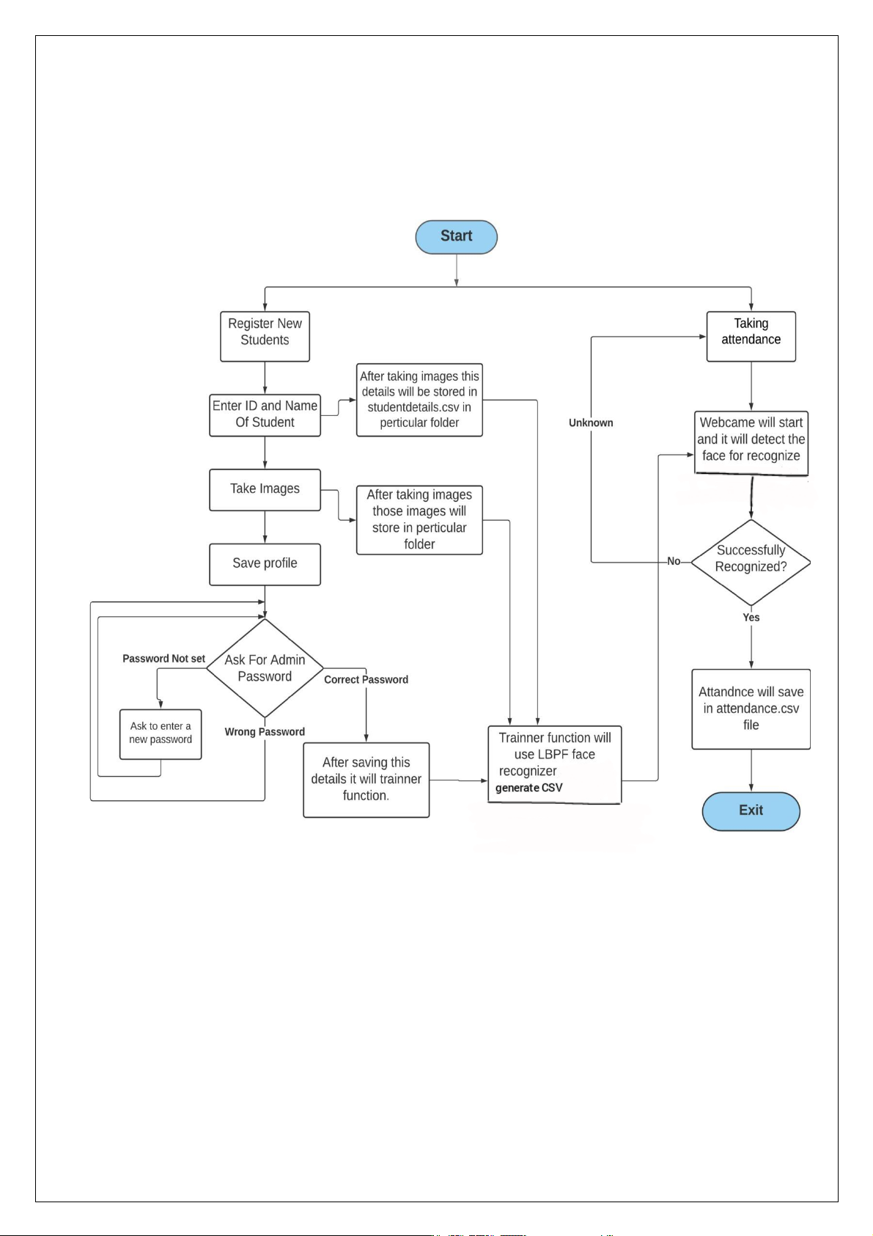
SYSTEM FLOW

Slide 9
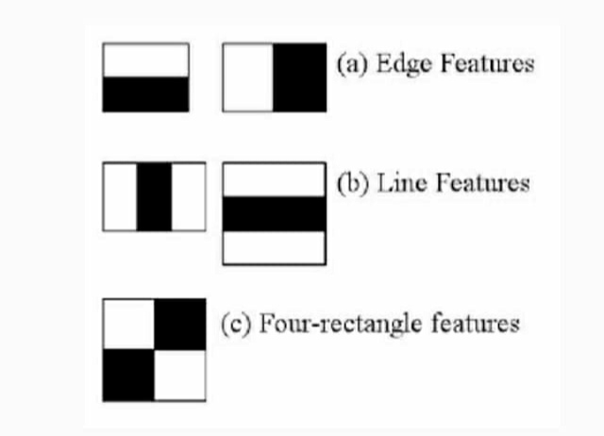
HAAR CASCADE ALGORITHM
It is an Object Detection Algorithm used to identify faces in an image or a real time.
The algorithm is given a lot of positive images consisting of faces, and a lot of negative images not consisting of any face to train on them.

Slide 10
LBPH ALGORITHM
The Local Binary Pattern Histogram(LBPH) algorithm is a simple solution on face recognition problem, which can recognize both front face and side face.
Local Binary Pattern (LBP) is a simple yet very efficient texture operator which labels the pixels of an image by thresholding the neighborhood of each pixel and considers the result as a binary number.

Slide 11
TRAINING MODEL
Training the Model: First, we need to train the model. To do so, we need to use a dataset with the facial images of the people we want to recognize.
We need to also set an ID (it may be a number or the name of the person) for each image, so the algorithm will use this information to recognize an input image and give you an output. Images of the same person must have the same ID.

Slide 12
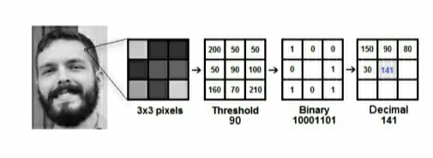
APPLYING LBP ALGORITHM
Create an intermediate image by highlighting the facial characteristics. To do so, the algorithm uses a concept of a sliding window, based on the parameters radius and neighbours.

Slide 13
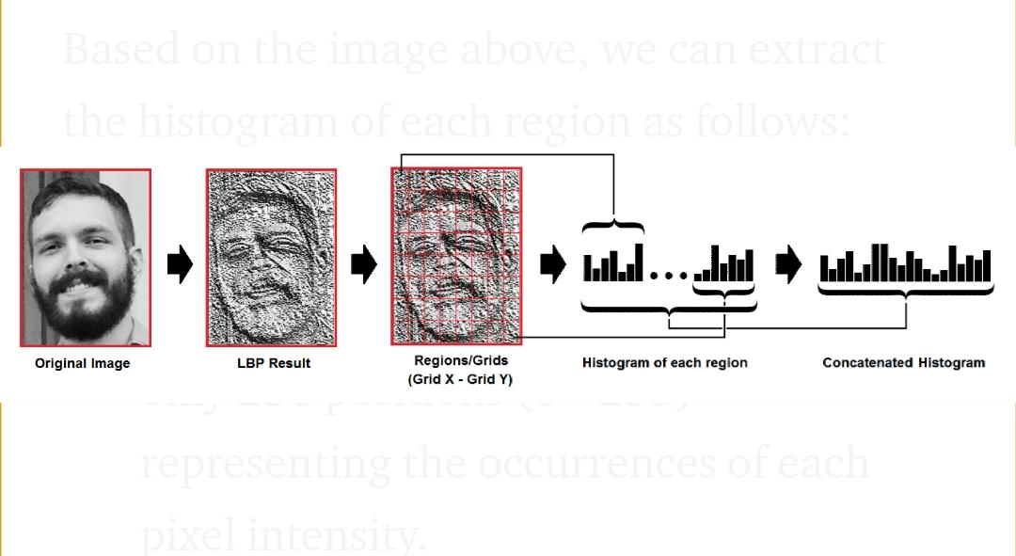
EXTRACTING HISTOGRAM
Now, using the image generated in the last step, we can use the Grid X and Grid Y parameters to divide the image into multiple grids, as can be seen in the following image:

Slide 14
PERFORMING THE FACE RECOGNITION
In this step, the algorithm is already trained. Each histogram created is used to represent each image from the training dataset. So, given an input image, we perform the steps again for new image and creates a histogram which represents the image.

Slide 15
REFERENCES
https://stackoverflow.com/questions/5412387/face-recognition
https://towardsdatascience.com/face-detection-in-2-minutes-using-opencv-python-90f89d7c0f81
https://pyimagesearch.com/2018/06/18/face-recognition-with-opencv-python-and-deep-learning/

Slide 16
THANK YOU

